Slide 1
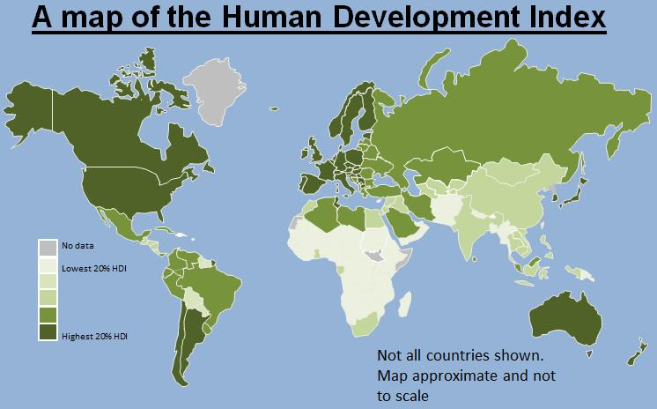
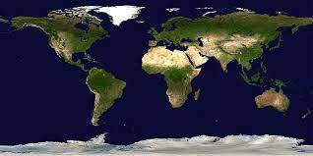
Data Engineering for World Development Indicators
https://www.kaggle.com/datasets/kaggle/world-development-indicators
By Team
Bhaskar Patil
Raghuram Iyengar
Michael Gattone
Prakash Srivastava

Slide 2
Project Initiation, Git Setup and Collaboration
Setup GIT Organization
Create GIT Repository
Add Team members to collaborate on the project files.
All team members cloned the repo and worked effectively to collaborate on the various aspects of the project
Explored and utilized Git LFS for handling large files over 100MB in Size

Slide 3
Project Scope
Data Engineering Process for the World development indicators data:
Develop ETL work flow to ingest data into the database
Data transformation from the original data
Set up the Postgres database for the project
Create ERD and database schema for the original data
Create tables in the database using database schema
Import and verify data from the original files into the database tables
Retrieve data from the database and display in pandas data frames
Analyze few top indicators for the world development

Slide 4
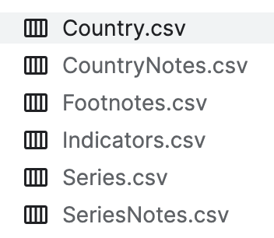
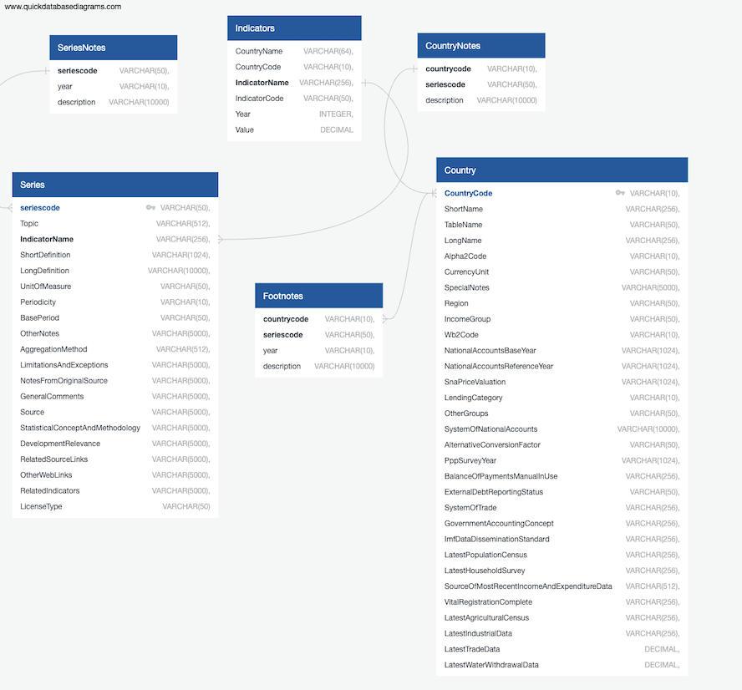
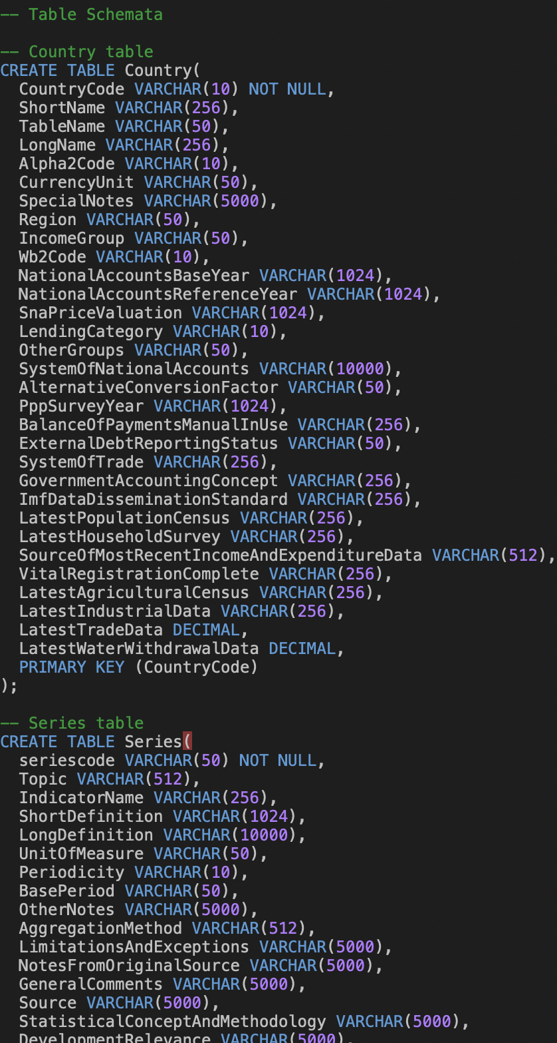
ETL
Extract Transform Load Activities
Original data in CSV files
ERD Diagram using QDB
Database schema

Slide 5
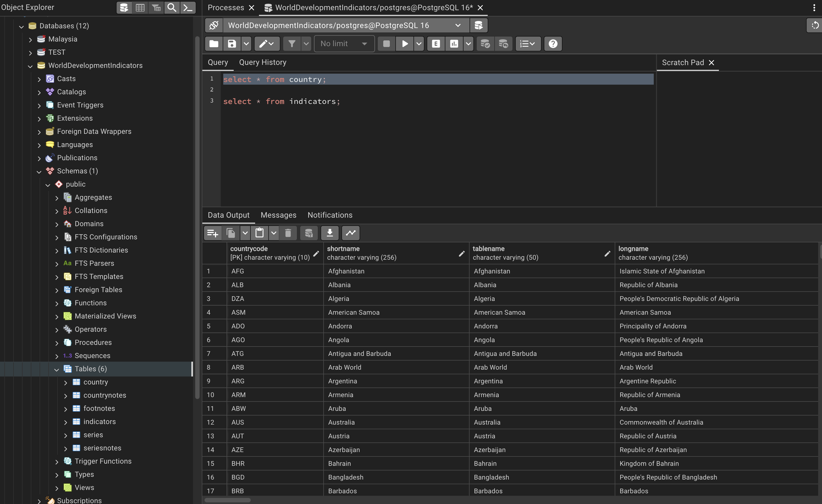
ETL
Extract Transform Load Activities Contd..
Database creation
Tables creation
Load data into the tables

Slide 6
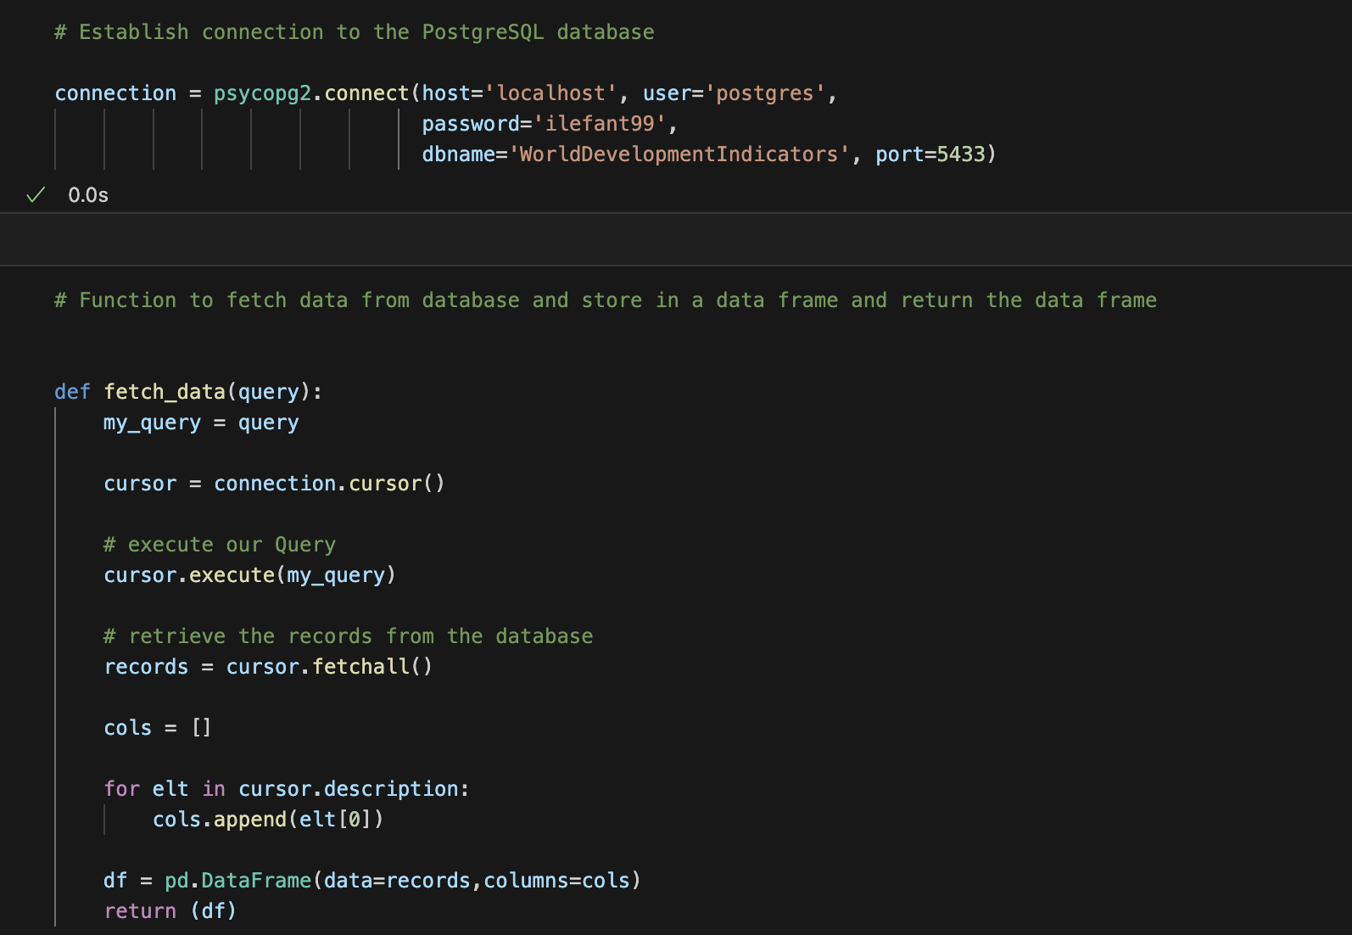
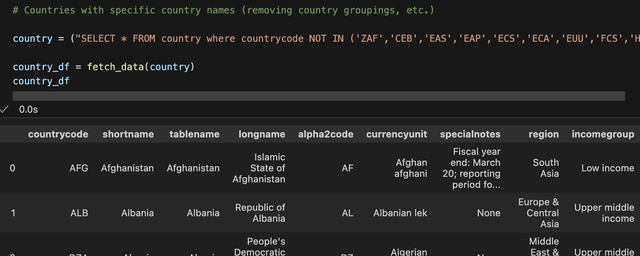
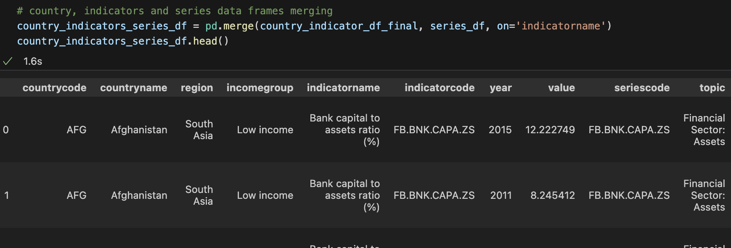
Retrieve data and prepare for analysis
Create a function to connect to database and fetch data into data frame
Use function and SQL query to get the data from a table
Prepare data frames for analysis

Slide 7
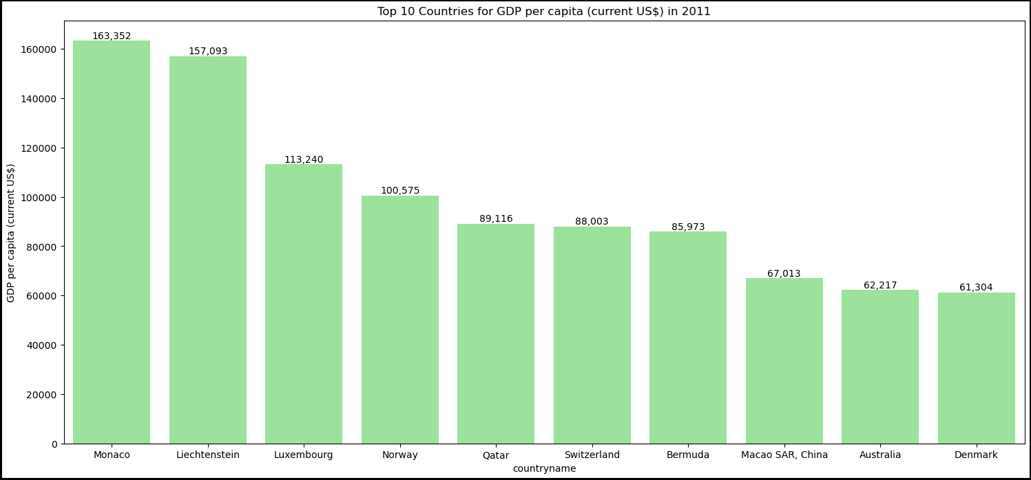
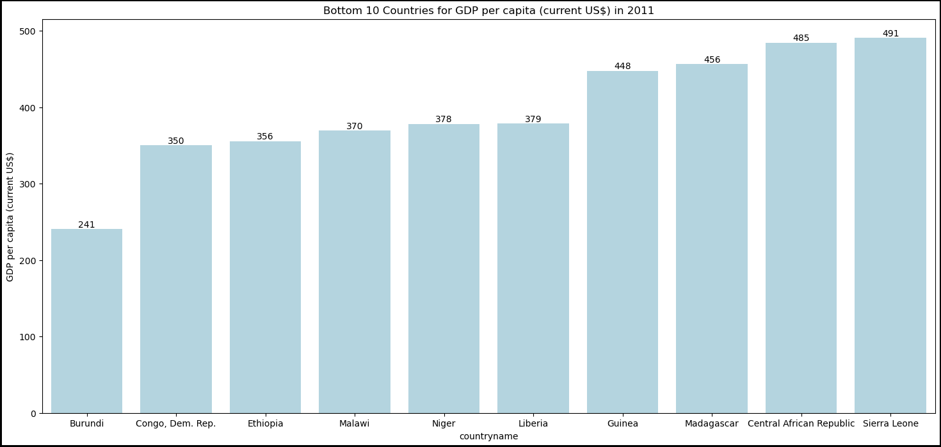
Top and Bottom10 Countries for GDP Per Capita

Slide 8
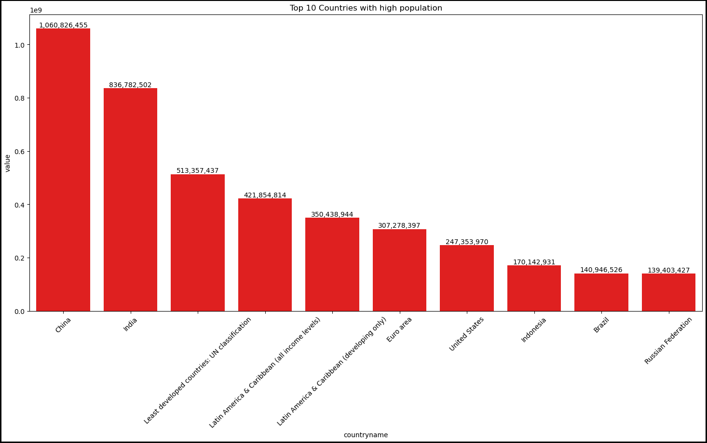
Top 10 Countries for Population

Slide 9
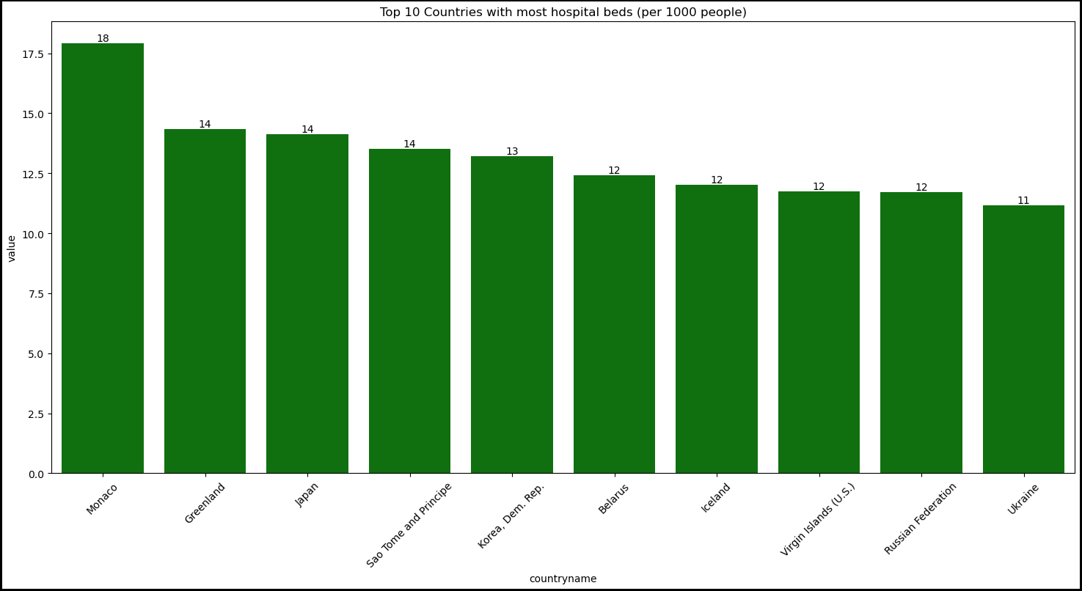
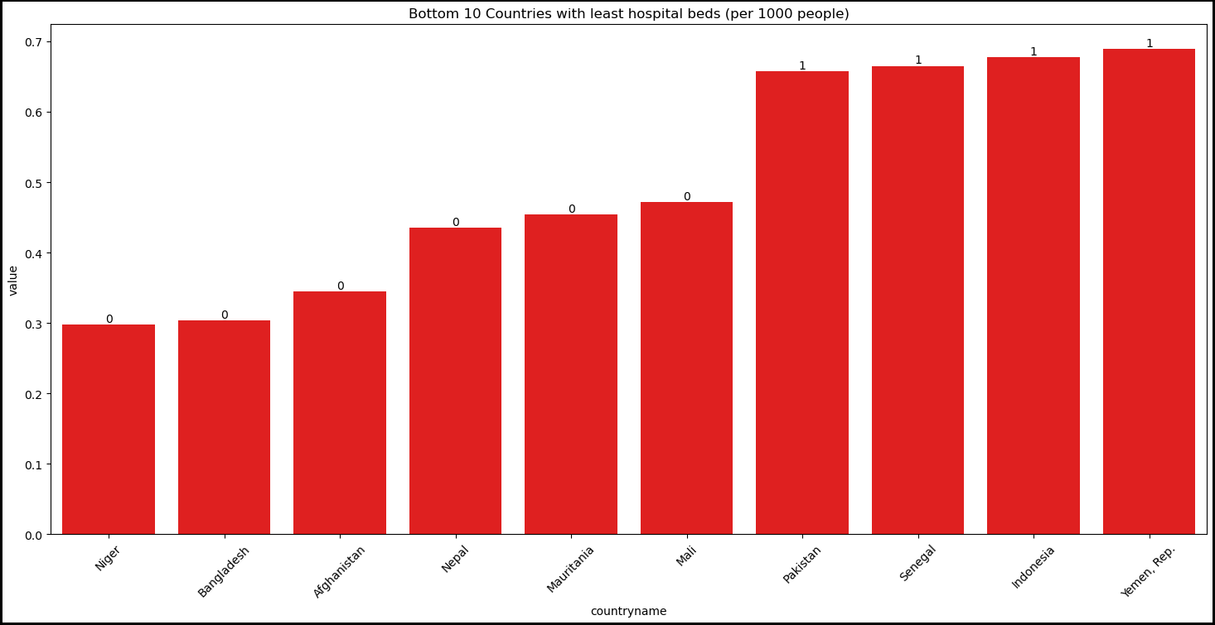
Top and Bottom 10 Countries for Hospital Beds

Slide 10
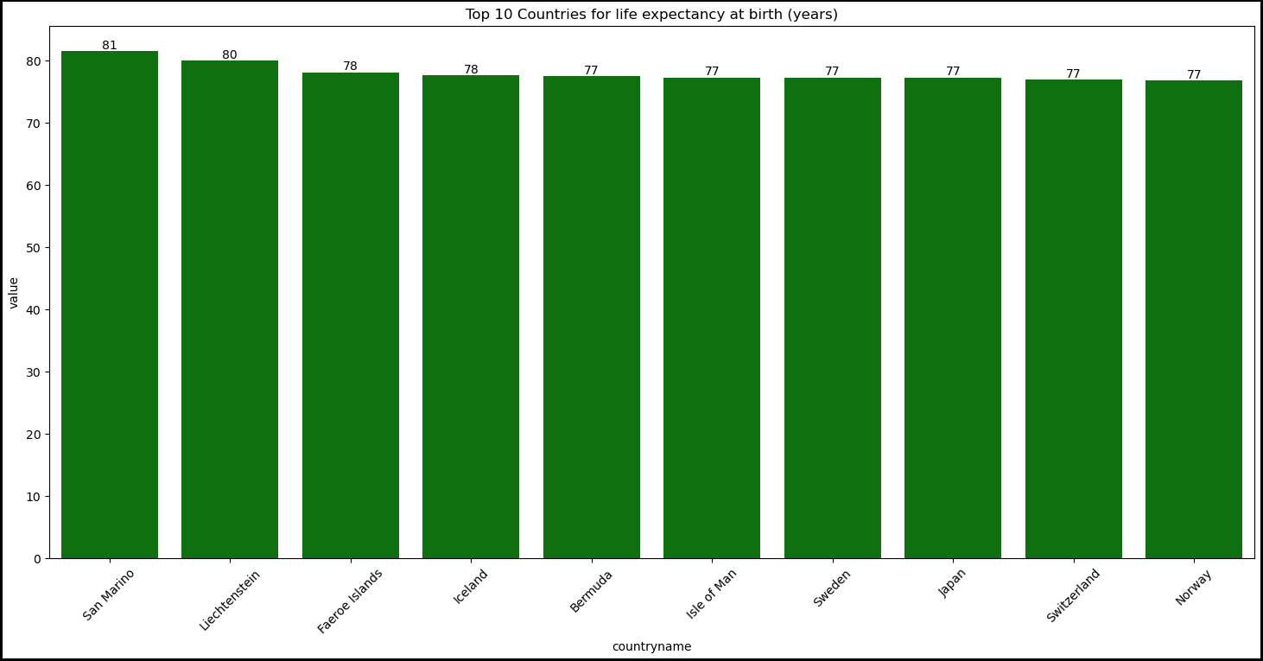
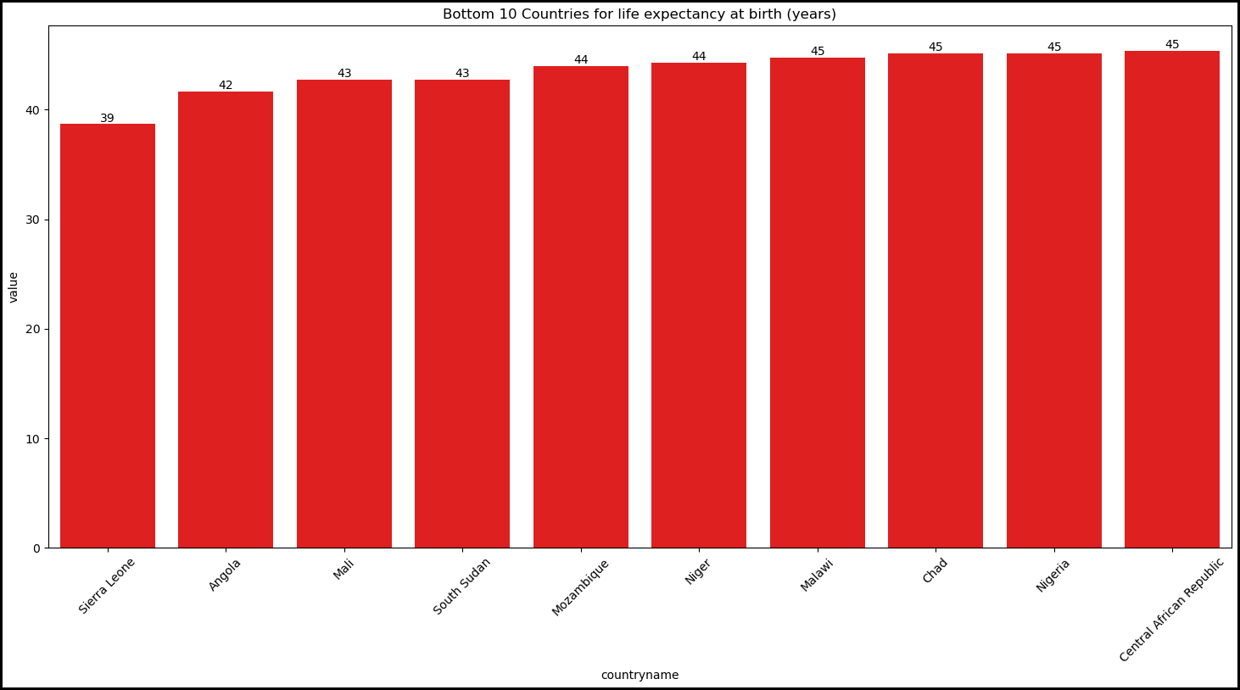
Top and Bottom 10 Countries for Life Expectancy

Slide 11
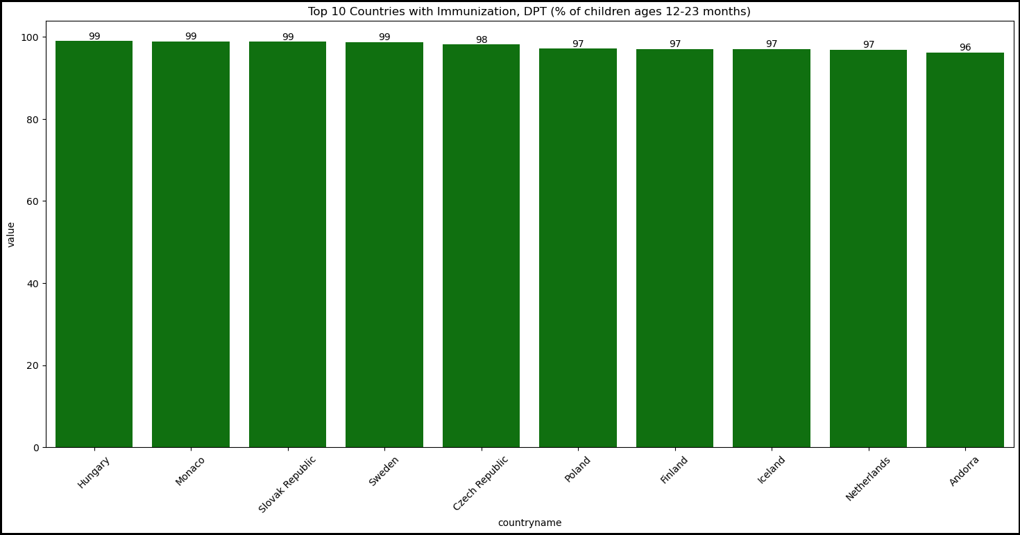
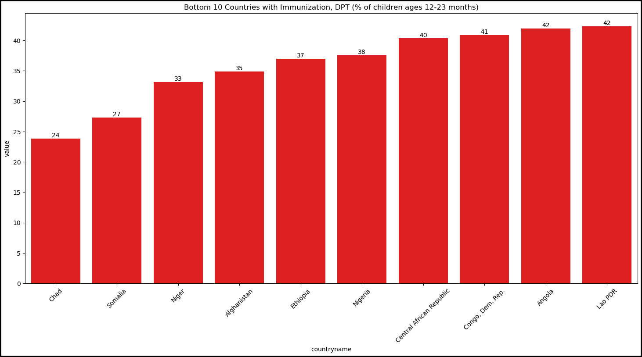
Top and Bottom 10 Countries for Immunization

Slide 12
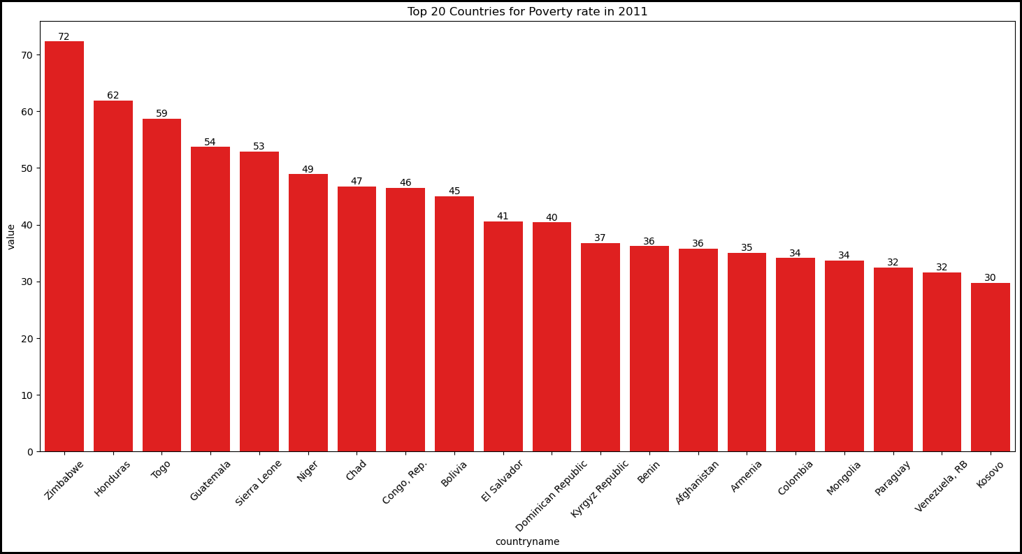
Top 20 Countries for Poverty Rate

Slide 13
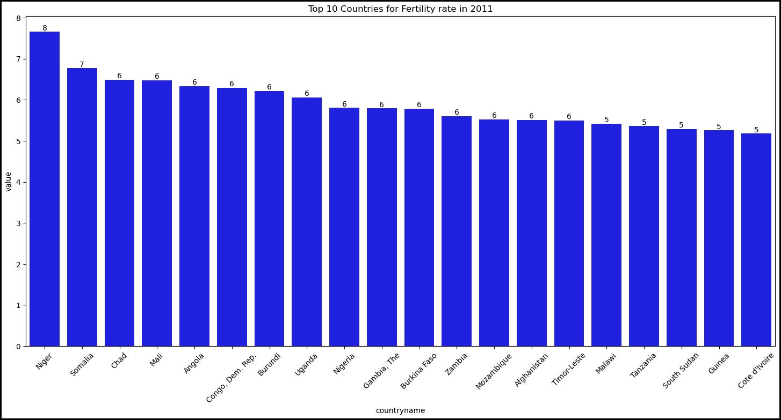
Top 20 Countries for Fertility Rate

Slide 14
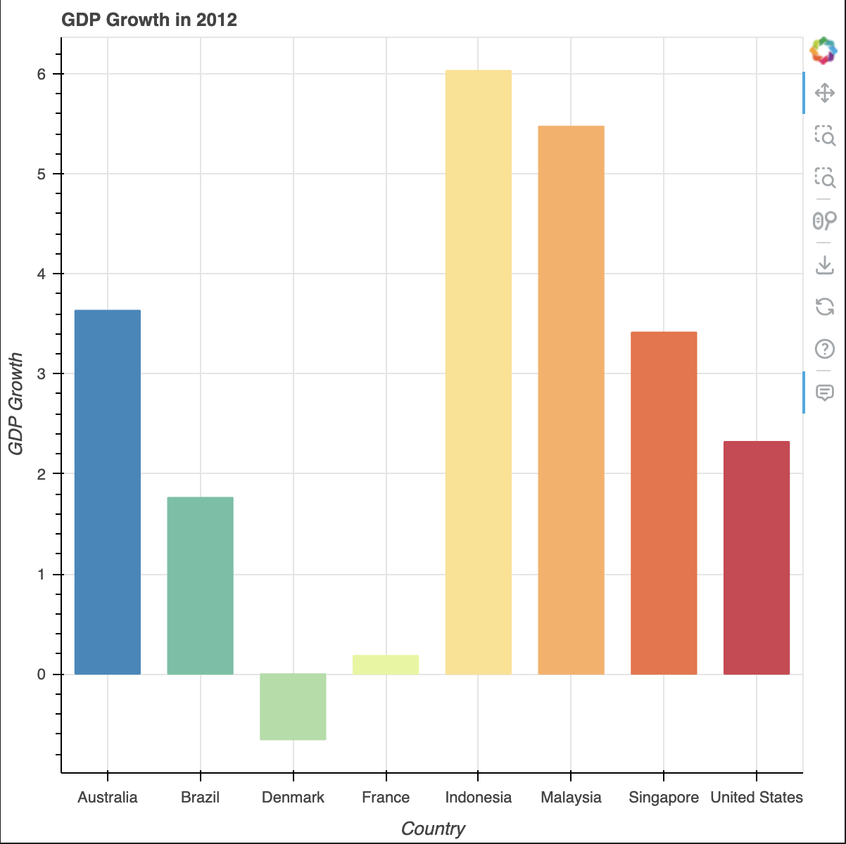
Countries GDP Growth Rate – Bokeh Plot

Slide 15
We did it…
Successful Factors:
Able to use Postgres, Python, QBD
PostgreSQL : Reliability and Scalability
Python: Versatility
Bokeh: Interactive Visualization
QBD: Ease of use to create ERD

